Slide 1

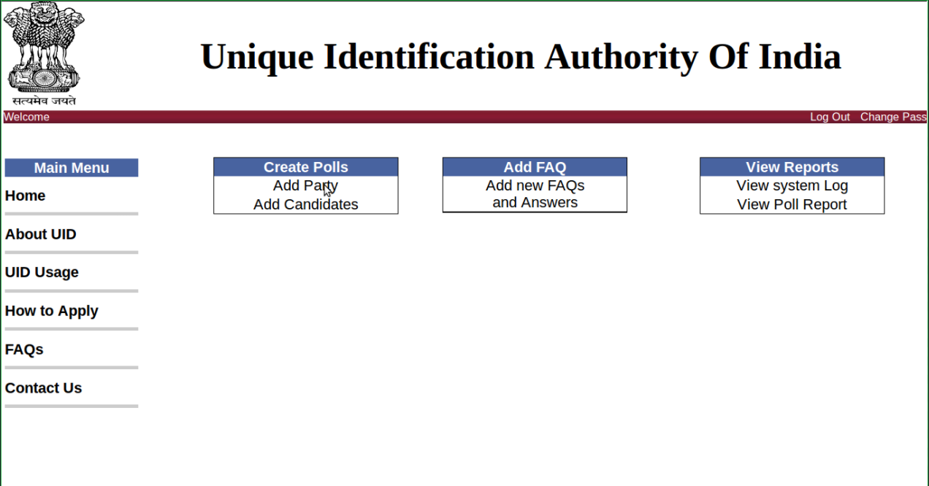
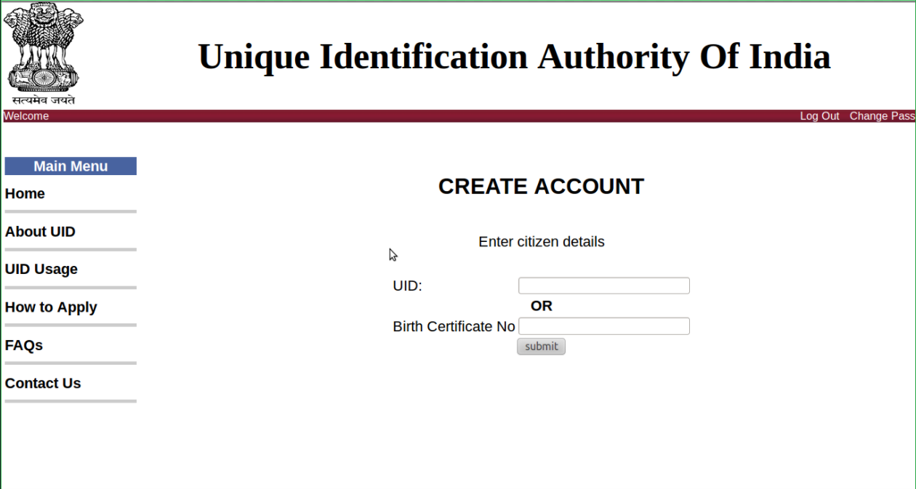
Design Demo Day 2022
GANDHINAGAR INSTITUTE OF TECHNOLOGY
“Where Success is a Tradition”
Unique ID Management System
Prepared by: (1) Sahil Panchal (190120107080) (2) Vishwas Patel (190120107112)
(3) Kabir Shah (190120107147)
Guided by: Prof. Shradha Prajapati
Introduction:
The Unique ID management is about maintaining a unique number for each and every citizen of the country. It will simplify the task of identity for an individual. Every citizen should have unique identification to find out personal information in each and every department or services wherever the citizen goes or do work. Unique identity can be provided with a birth certificate. After attaining age of 18 every citizen should be provided with a password to access the site which is assigned to apply for ID.
2. Observations:
The biggest Limitations in the existing IDs is that they serve different purpose and the level of cross acceptance of these id is minimal. The person below 18 (age) do not have unique identification. To find information about any person, government department such as police department, CBI, need to gather information manually. For any type of connections such as electric, phone, water supply and for passport / visa, applicant is required to submit their complete documents at respective department. And then respective department verify documents then provide respective facilities.
3. Understanding of Canvases:
Empathy Mapping
An empathy map is a collaborative visualization used to articulate what we know about a particular type of user. It externalizes knowledge about users in order to 1) create a shared understanding of user needs, and 2) aid in decision making.
Mind Mapping
Mind mapping is the sheet on which all the thoughts are given a proper route and are classifies under specific headings based on the activities. It consists of all the random thoughts running through the mind when the topic name is heard.
4. Functionalities:
User Login : Every citizen can login and access their information page.
Security: A normal user other than Government officers, moderators and administrators can only access his/her information. For information update they must approach corresponding office to get approval.
Security Officials Login: Authorized Security person in police, army, and airline should give a unique ID and password to access to information of all users.
Admin : Admin can modify the entire coding and structure of the system. Admin can have access to detail of all users. He can modify the entire database.
Admin can change his/her detail without approval.
Change of photo of every user after 3 years is mandatory
5. Photographs of prototype

